Slide 1
SC-200T00A Microsoft Security Operations Analyst
Author name Date

Slide 2
Module 7: Create detections and perform investigations using Azure Sentinel

Slide 3
Module agenda
Threat detection with Azure Sentinel analytics
Threat response with Azure Sentinel playbooks
Security incident management in Azure Sentinel
Use entity behavior analytics in Azure Sentinel
Query, visualize, and monitor data in Azure Sentinel

Slide 4
Lesson 1: Threat detection with Azure Sentinel analytics

Slide 5
Lesson introduction
After this lesson, you will be able to:
Explain the importance of Azure Sentinel Analytics.
Explain different types of analytics rules.
Create rules from templates.
Create new analytics rules and queries using the analytics rule wizard.
Manage rules with modifications.

Slide 6
Azure Sentinel Analytics explained
Overview
Azure Sentinel Analytics analyzes data from various sources to identify correlations and anomalies.
By using analytics rules, you can trigger alerts based on the attack techniques that are used by known malicious actors.
You can set up these rules to help ensure your SOC is alerted to potential security incidents in your environment in a timely fashion.
Common security analytics use cases include:
Identification of compromised accounts
User behavior analysis to detect potentially suspicious patterns
Network traffic analysis to locate trends indicating potential attacks
Detection of data exfiltration by attackers
Detection of insider threats

Slide 7
Types of analytics rules
Microsoft security
Scheduled alerts
Fusion
Machine learning (ML) behavior analytics

Slide 8
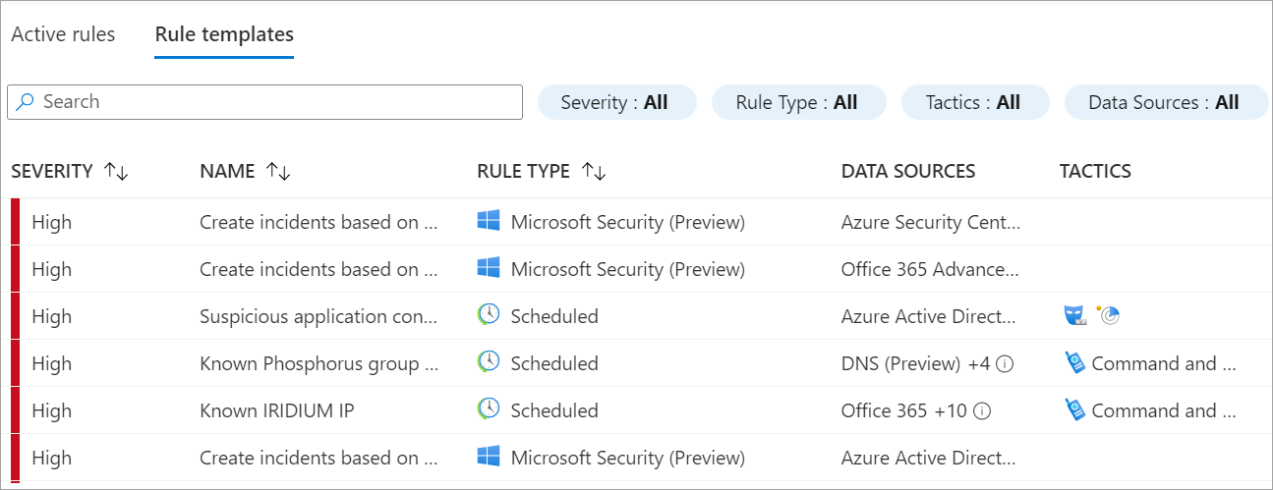
Create an analytics rule from a template
The Analytics section in Azure Sentinel contains rule templates that are preloaded from the Azure Sentinel GitHub repository. You can use these templates to create a rule to detect security threats.

Slide 9
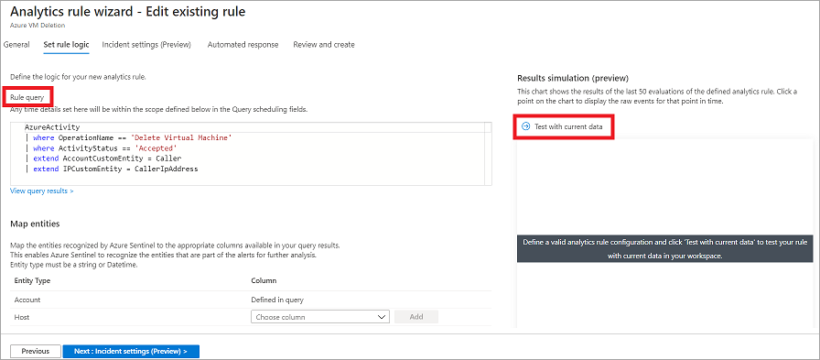
Create an analytics rule from a wizard
Creating a custom rule from the scheduled query rule type provides you with the highest level of customization. You can define, your own KQL code, set a schedule to run the alerts, or provide an automated action by associating an Azure Sentinel Playbook.

Slide 10
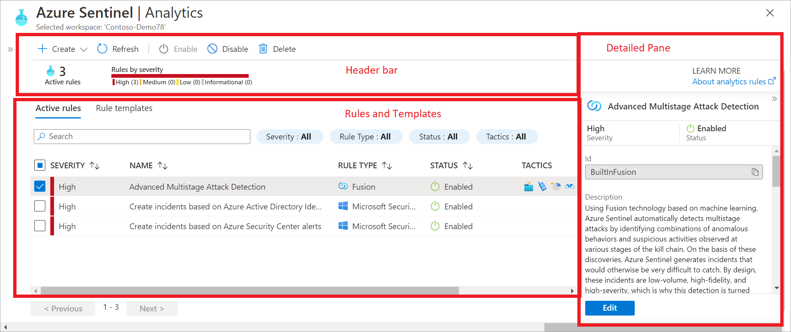
Manage analytics rules
To adjust the noise and filter the more important threats detected, you should manage the analytics rules on an ongoing basis. This will help ensure that your rules remain useful and efficient in detecting potential security threats.
Notes:
Instructor demonstration:
Manage rules
Create a Security Rule from a template
Create a Security Rule from the menu
Create a Scheduled Query

Slide 11
Section break

Slide 12
Lesson 2: Threat response with Azure Sentinel playbooks

Slide 13
Lesson introduction
After this lesson, you will be able to:
Explain Azure Sentinel SOAR capabilities
Explore the Azure Sentinel Logic Apps connector
Create a playbook to automate an incident response
Run a playbook on demand in response to an incident

Slide 14
Azure Sentinel playbooks explained
Azure Sentinel as a SIEM and SOAR solution
Security Orchestration, Automation and Response (SOAR) solution
Azure Sentinel playbooks
Security playbooks are collections of procedures based on Azure Logic Apps that run in response to an alert.
Azure Logic Apps
Azure Logic Apps is a cloud service that automates the operation of your business processes.
Logic Apps Connector
A connector is a component that provides an interface to a service.
Triggers and Actions
A trigger is an event that occurs when a specific set of conditions is satisfied. An action is an operation that performs a task.
Azure Sentinel Logic Apps connector
An Azure Sentinel playbook uses an Azure Sentinel Logic Apps connector.
Notes:
Read squares from left to right then second row.

Slide 15
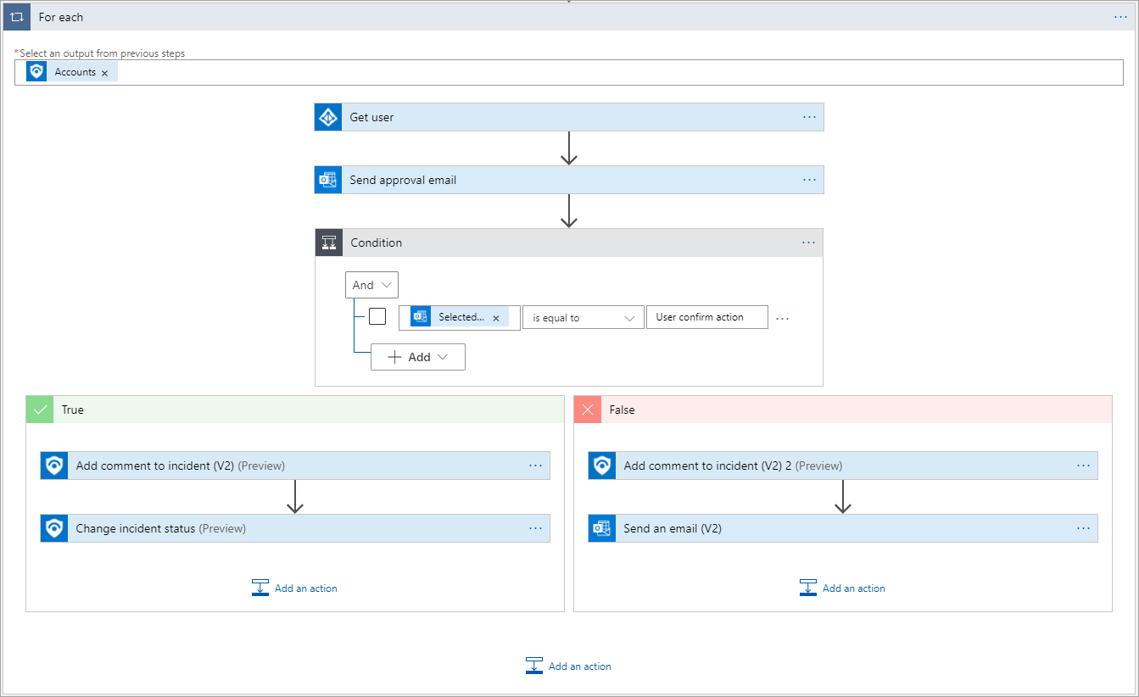
Create a Logic App
The Logic App Designer provides a design canvas that you use to add a trigger and actions to your workflow.

Slide 16
Run a playbook on demand
1
Manually from an Incident
2
Automatically from an Analytics Rule
Notes:
Instructor demonstration:
Create a Logic App
Configure a Scheduled Query to use a Playbook

Slide 17
Section break

Slide 18
Lesson 3: Security incident management in Azure Sentinel

Slide 19
Lesson introduction
After this lesson, you will be able to:
Understand Azure Sentinel incident management
Explore Azure Sentinel evidence and entity management
Investigate and manage incident resolution

Slide 20
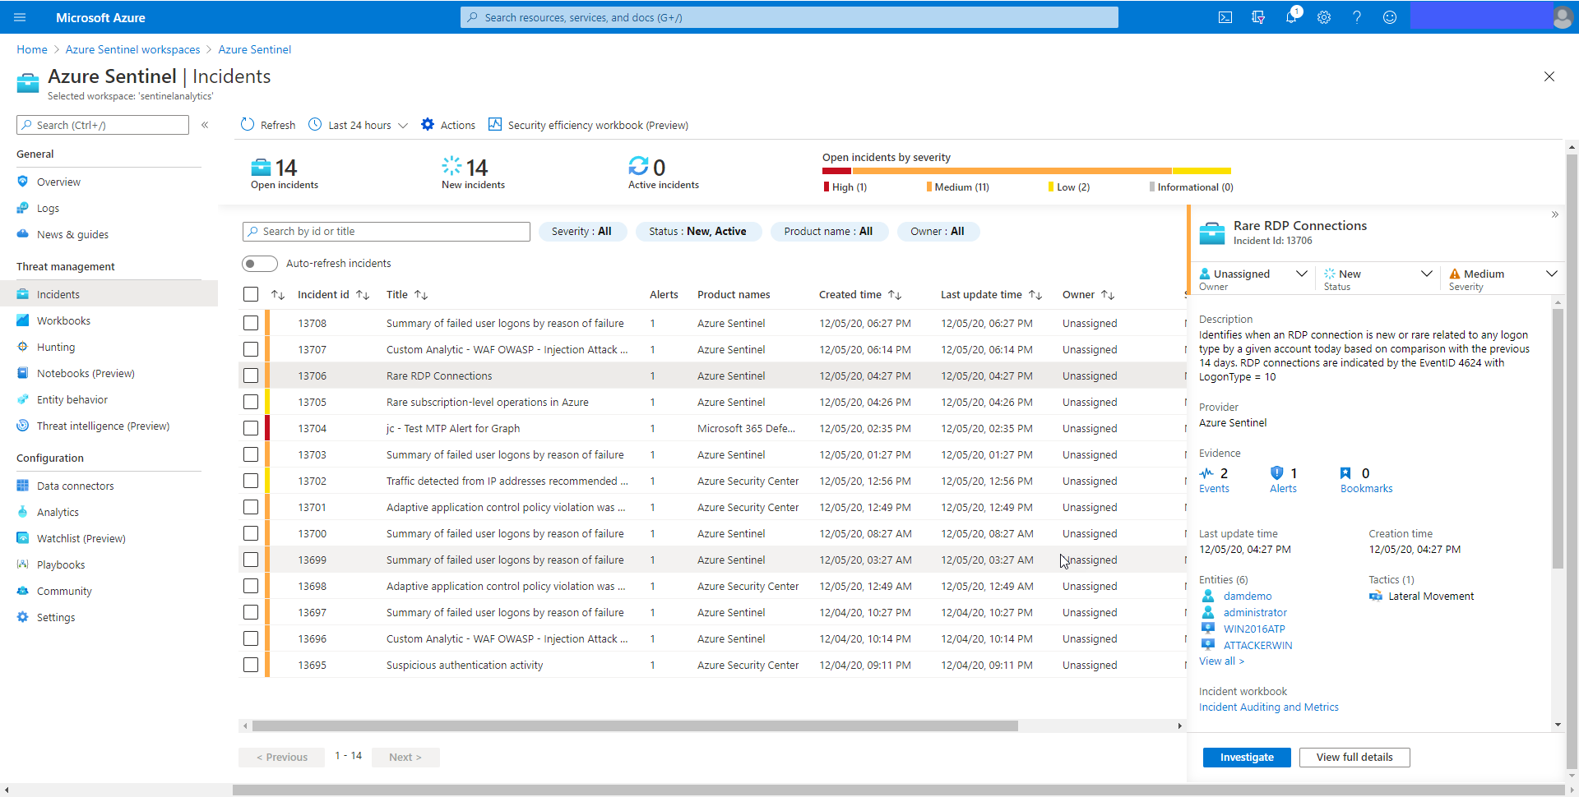
Describe incident management
Incident management is the complete process of incident investigation, from creation, to in-depth investigation, and finally to resolution.

Slide 21
Explain evidence and entities
Events
Alerts
Entities
Incidents
Bookmarks

Slide 22
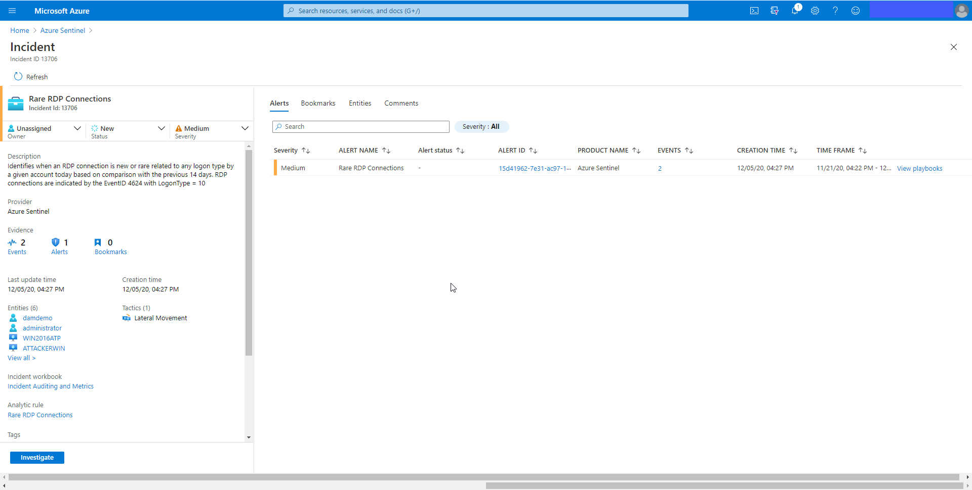
Investigate incidents
Incident management is the complete process of incident investigation, from creation, to in-depth investigation, and finally to resolution.
Notes:
Instructor demonstration:
- Explore Incidents

Slide 23
Section break

Slide 24
Lesson 4: Use entity behavior analytics in Azure Sentinel

Slide 25
Lesson introduction
After this lesson, you will be able to:
Explain User and Entity Behavior Analytics in Azure Sentinel
Explore entities in Azure Sentinel

Slide 26
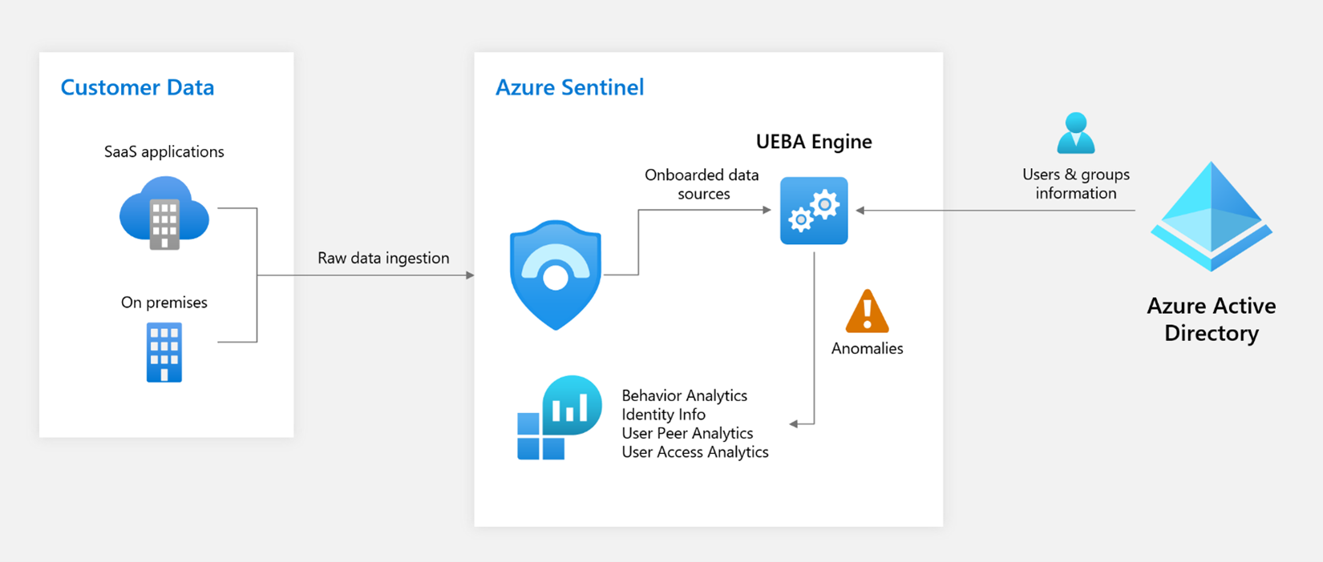
User and entity behavior analytics explained
Notes:
As Azure Sentinel collects logs and alerts from all of its connected data sources, it analyzes them and builds baseline behavioral profiles of your organization’s entities (users, hosts, IP addresses, applications etc.) across time and peer group horizon. Using various techniques and machine learning capabilities, Sentinel can then identify anomalous activity and help you determine if an asset has been compromised.

Slide 27
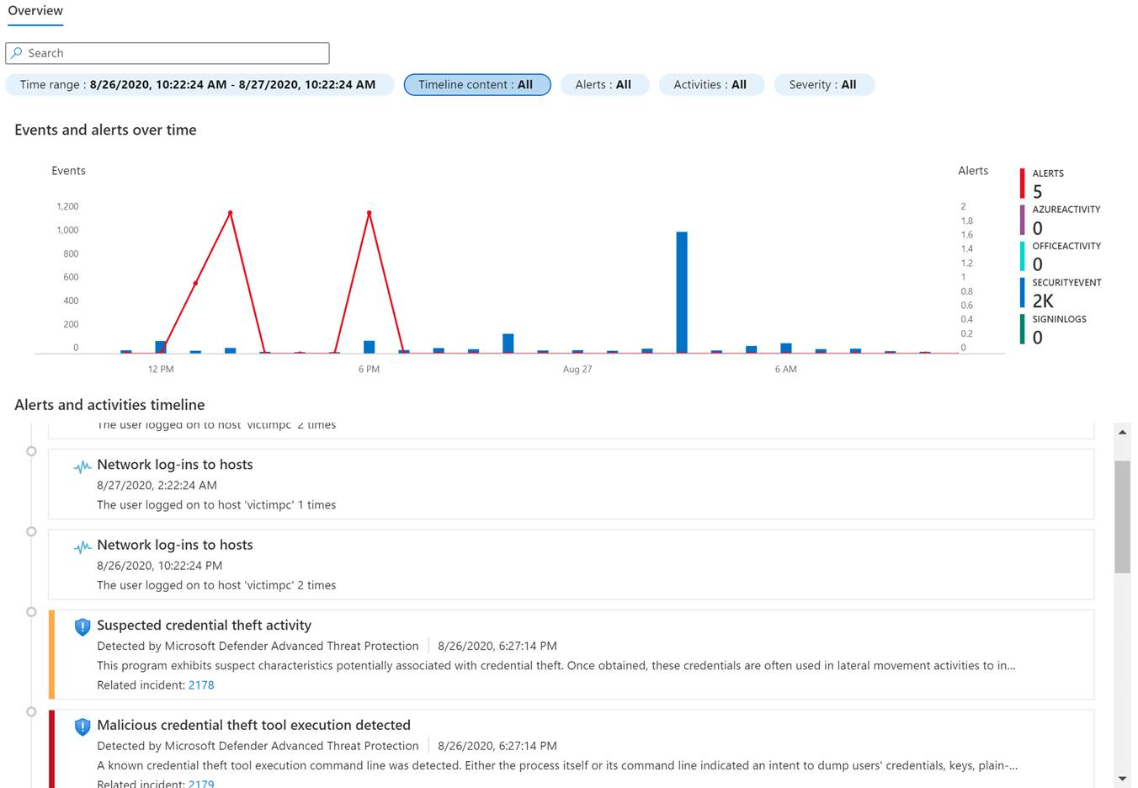
Explore entities
Notes:
When you encounter any entity in a search, an alert, or an investigation, you can select the entity and be taken to an entity page, a datasheet full of useful information about that entity. The types of information you will find on this page include basic facts about the entity, a timeline of notable events related to this entity and insights about the entity's behavior.

Slide 28
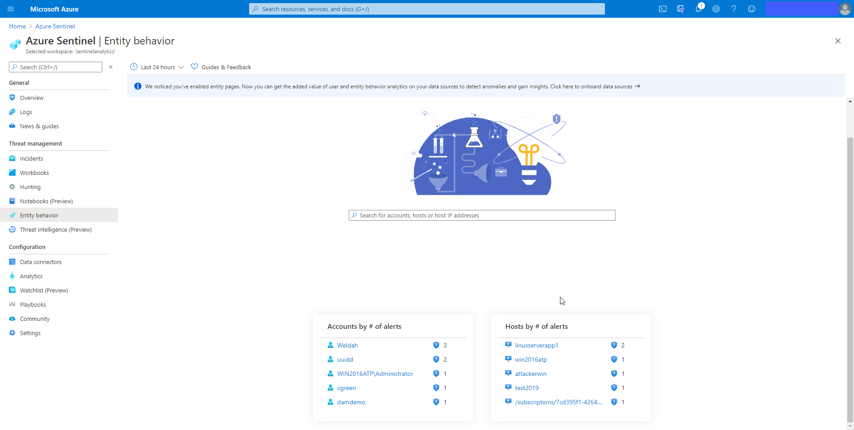
Display entity behavior information
The Entity behavior page allows you to search for entities or select from the list of already displayed entities. Once selected the Entity page is displayed with information and timeline of alerts and activities
Notes:
Instructor demonstration:
- Explore Entity behavior

Slide 29
Section break

Slide 30
Lesson 5: Query, visualize, and monitor data in Azure Sentinel

Slide 31
Lesson introduction
After this lesson, you will be able to:
Visualize security data using Azure Sentinel Workbooks
Explain Workbook queries
Explore Workbook capabilities
Create an Azure Sentinel Workbook

Slide 32
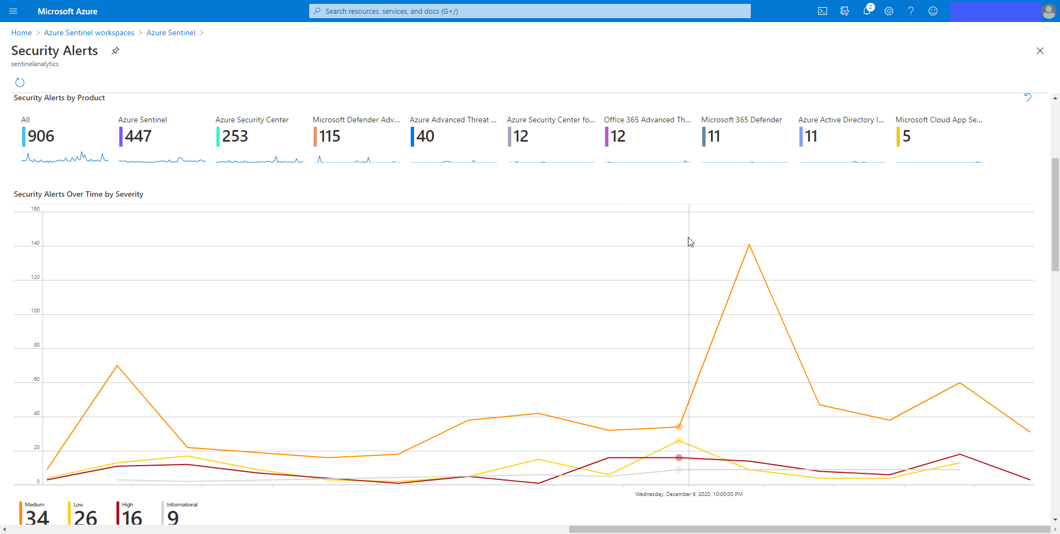
Azure Sentinel Workbooks
Workbooks provide a dashboard like interface. There are Workbooks provided by Azure Sentinel and the community. You can also create your own Workbooks.

Slide 33
Create a new Azure Sentinel Workbook
1
Text visualizations
6
Links/tabs
2
Query item
7
Metric steps
3
Chart visualizations
4
Grid visualizations
5
Parameters
Notes:
Instructor demonstration:
Explore Workbooks
Create a new Workbook

Slide 34
Section break

Slide 35
Knowledge check
Check your knowledge with the module quiz in your course viewer

Slide 36
Lab 01 – Create detections and perform investigations using Azure Sentinel

Slide 37
Lab Exercises
1
Activate a Microsoft Security rule
5
Conduct attacks
2
Create a playbook
6
Create detections
3
Create a scheduled query
7
Investigate incidents
4
Understand detection modeling
8
Create workbooks

Slide 38
Closing slide

